Slide 1

DIVIDED WE STAND: Building a Community that Embraces Difference
Chris Conway & John T. Delaney

Slide 2

We Live in a World Divided
How do you build a community that embraces difference in a divided world?
We are divided for many reasons:
  Our political leaders benefit from divisions
  Division is common in universities too

Slide 3
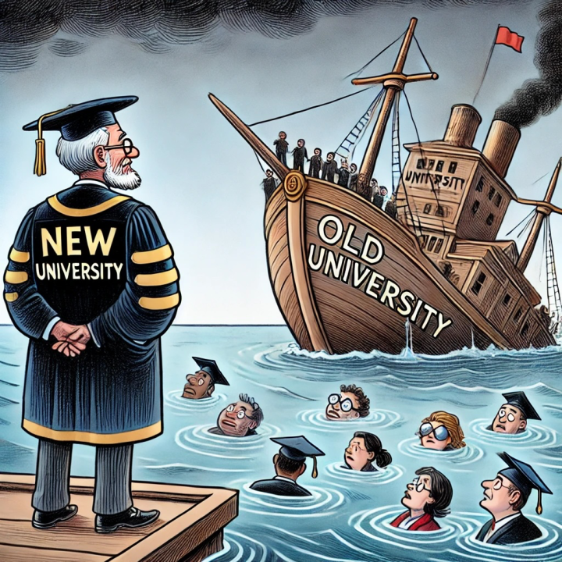
Competition in Higher Education Magnifies Divisions
University Closures create fear and caution
  Does it matter if you value difference?
Many organizations say they value everyone and have policies that offer lavish rewards to some & minimal ones to others
Must we undermine others to succeed?

Slide 4
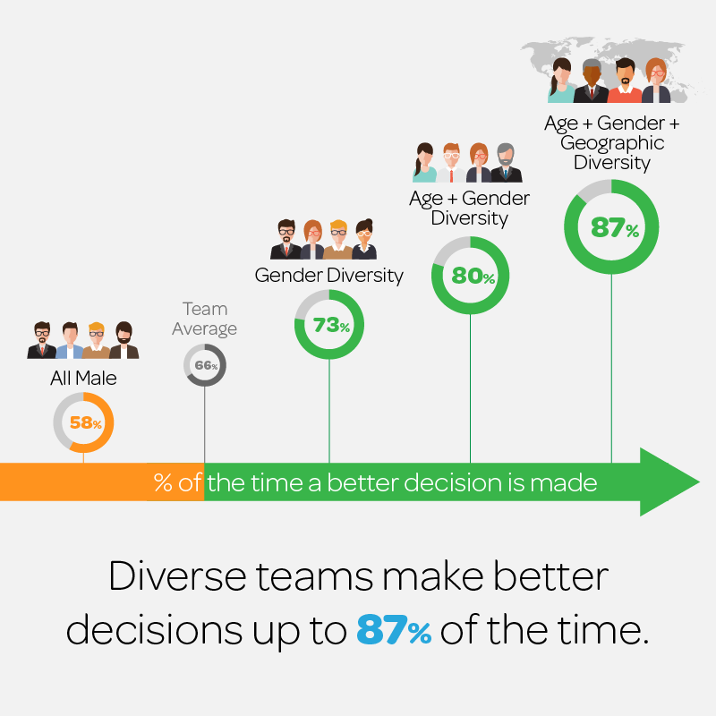
Benefits of Valuing Difference
Substantial Evidence shows diverse teams produce superior results – performance, creativity, innovation, productivity
Diversity in the population is increasing
Universities need international and nontraditional students

Slide 5
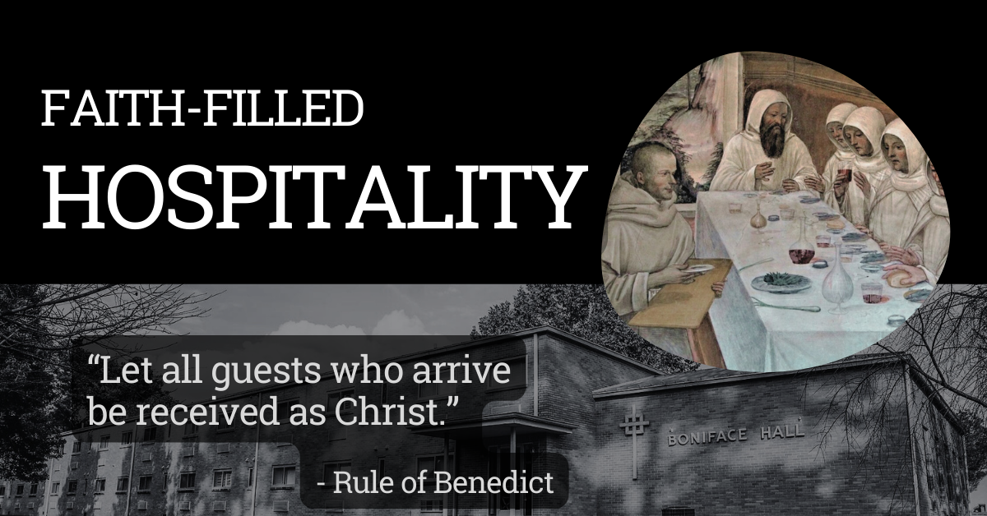
Moral Reasons for Valuing Difference
The Rule
Respect for Human Dignity
Social Justice

Slide 6
Benedictine Wisdom Points a Way Forward
“The Institution [the university] will not love you back”
“Benedictine colleges and universities seek, above all, to be grounded in love and animated by it…We recognize how easy it is for all to hold on to habits of mind and behavior that diminish one’s own potential or impede the development of others. Yet we possess a confidence borne of long experience in the capacity of all persons to grow and develop, to cultivate habits of mind and behavior that are life-giving and contribute to the good of all.” Bill Cahoy, “ABCU: Education within the Benedictine Wisdom Tradition,” 2006.
We value difference out of love

Slide 7
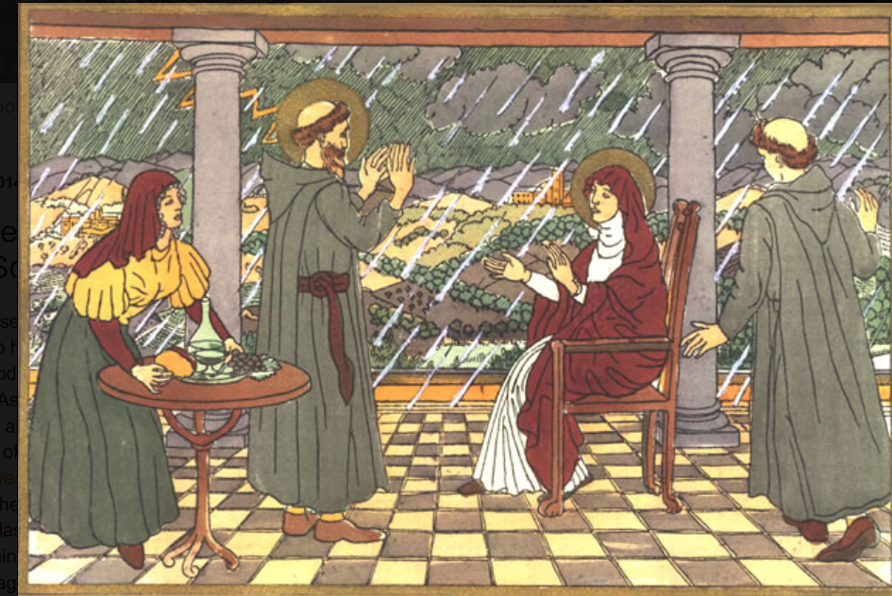
St. Scholastica’s Love
“Do we not read in St. John that God is love?
Surely it is no more than right that her influence was greater than his, since hers was the greater love.”
Life and Miracles of
St. Benedict, Gregory the Great, ch. 34

Slide 8
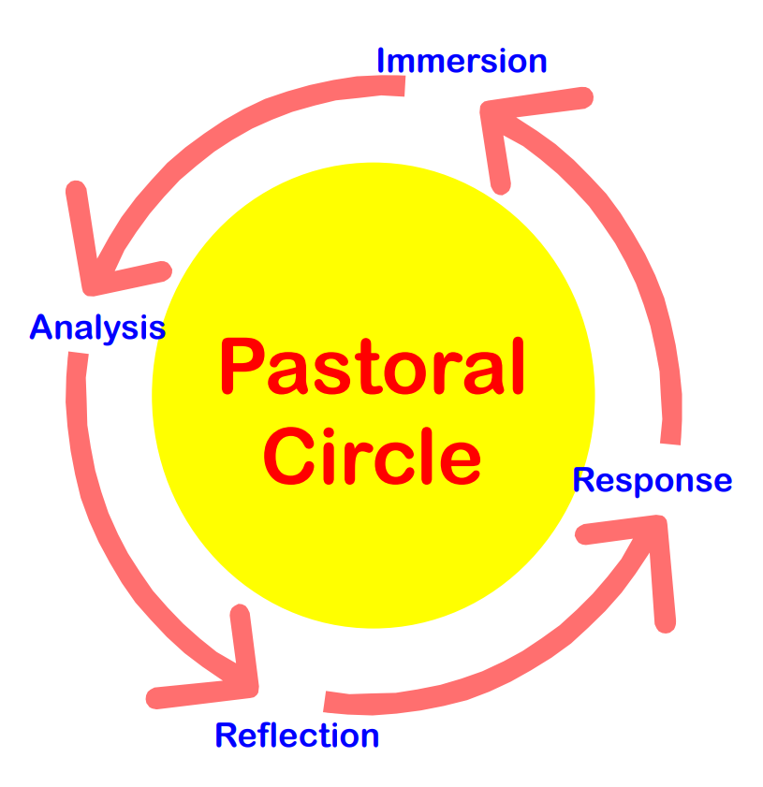
The Pastoral Circle Method – Addressing Difficult Decisions
  Immersion: where one has the experience of the social issue
  Analysis: where one uncovers the root causes and values of the issue
  Reflection: where one judges on the issue and the causes based on their own moral value system
  Response: where one acts on the judgments in a manner consistent with their moral values
  From “Pastoral Circle,” John Gonzalez

Slide 9
Benedictine Tradition
The 10 Hallmarks
  Love
  Prayer
  Stability
  Conversatio
  Obedience
  Discipline
  Humility
  Stewardship
  Hospitality
  Community

Slide 10
Small Group Discussion
Form into groups of 6-10 people
Identify a facilitator
  Facilitator manages discussion of the questions
Identify a recorder
  Recorder takes notes and provides feedback to assembly when requested

Slide 11
Questions/Scenarios
Select and answer one of the following questions:
  How would you counsel students who approached you asking what they could do to support Palestinians in Gaza? And what would you say about the issue of antisemitism?
  How would you recommend your university respond to a request by ICE to interview any undocumented students on campus? Make sure to consider all the implications.
  The university community wants a strong response to illegal government actions and some have suggested that kindness is the equivalent of appeasement. How do you respond?
  What would you say to a campus group that asked for funds to hold a conference on the effect of the U.S. Travel Ban on people from blacklisted countries?

Slide 12
Feedback to the Assembly
Why value difference

Slide 13
Conclusion and Food for Thought
This is not a drill
  Your answers could provoke a government investigation or attack
  Must we hide support for difference to protect the institution?
Secondary danger: pressure for consolidation in higher education will advance after the government and markets have weakened smaller institutions
  Large institutions are better prepared for the challenge
Although this will weigh heavily on our Abbots and Presidents, everyone will likely be called for counsel as the consequences fall on us all

Slide 14
THANK YOU

Slide 15
Overview
Why focus on division if goal is to embrace difference?
Environment is accentuating societal differences – even in universities
Underlying value of embracing difference
  Rational reasons
  Increasing population diversity
  Enrollment of international students
  Moral reasons

Slide 16
Conclusion
Engaging differences critical to future of universities despite expected federal government attacks
  Coordination across institutions?
Secondary danger: pressure for consolidation of universities
  Large institutions are better prepared for the challenge
Consequences of decisions on all of us
  Not an issue solely for Presidents or Abbots

